Slide 1
WELCOME TO OPEN HOUSE
Mrs. Johnson
ajohnson@mtctampa.org
Science
2022-2023
Mother Teresa of Calcutta Catholic School

Slide 2
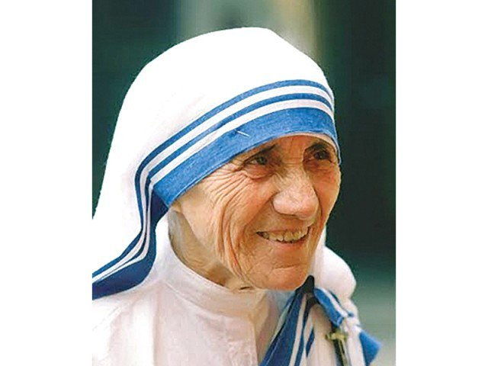
MY GOALS
All my students will perform and learn at rigorous levels.
Students will be challenged and learn to persevere using problem solving strategies.
Students will set goals for themselves, and I will help them exceed those goals daily.
Students will feel encouraged, supported, and safe in my classroom at all times.
Our Mission Statement: Inspired by Mother Teresa of Calcutta and rooted in the Catholic faith, our mission is to develop young people who strive for academic excellence, recognize the dignity of each individual and foster service to others.

Slide 3
SCIENCE UNITS: GRADE 6 Earth Science
1. Metric Measurement and Scientific Method
2. Introduction to Earth’s System
3. Weather and Atmosphere
4. Rocks and Minerals
5. Plate Tectonics
6. Earth’s Surface Systems
7. Distribution of Natural Resources
8. Human Impacts on the Environment

Slide 4
SCIENCE UNITS: GRADE 6 Earth Science
9. History of the Earth
10. Energy in the Atmosphere
11. Climate
12. Earth-Sun-Moon Systems
13. Solar System and the Universe

Slide 5
SCIENCE UNITS: GRADE 7 Life Science
1. Metric Measurement and Scientific Method Review
2. Living Things in the Biosphere
3. The Cell System
4. Human Body Systems
5. Dissections
6. Reproduction and growth
7. Genes and Heredity
8. Eco Systems

Slide 6
SCIENCE UNITS: GRADE 7 Life Science
9. Populations, Communities, and Ecosystems
10. Natural Selection and Change Over Time

Slide 7
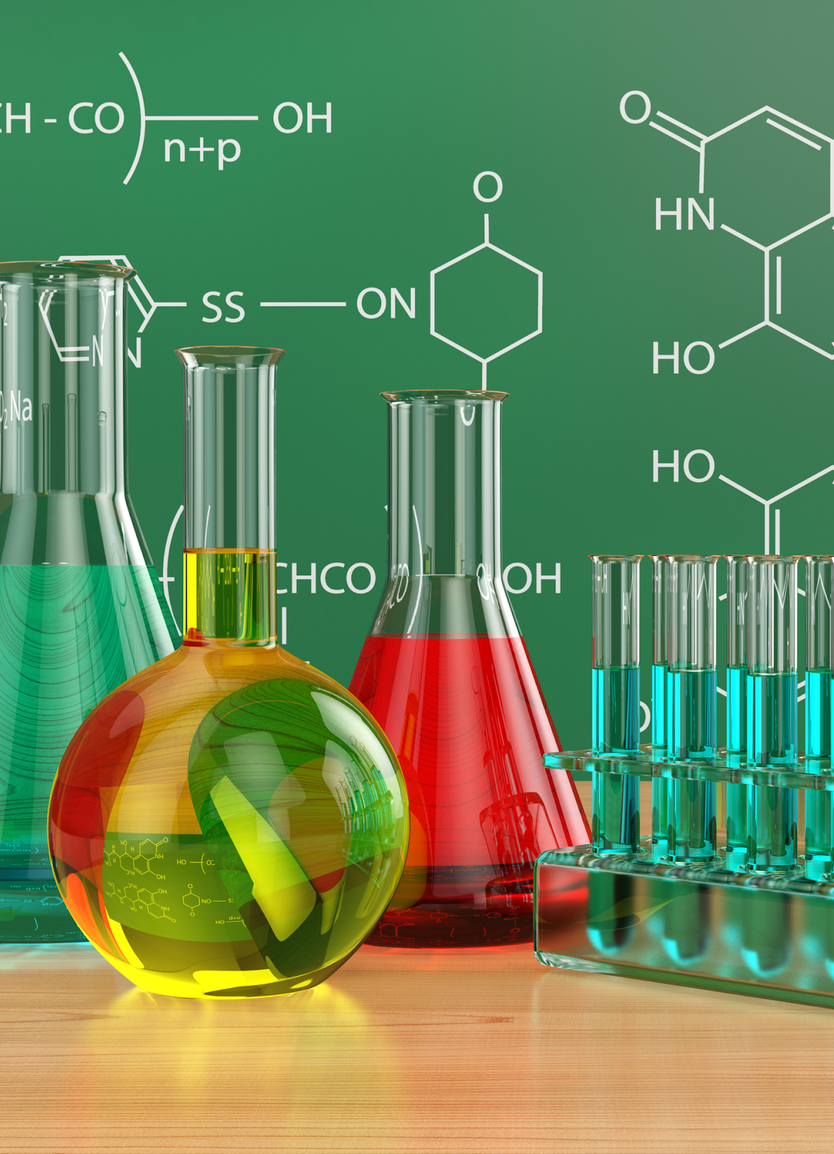
SCIENCE UNITS: GRADE 8 Physical Science
1. Metric Measurement and Scientific Method Review
2. Introduction to Matter
3. Solids, Liquids, and Gases
4. Atoms and the Periodic Table
5. Chemical Reactions
6. Energy
7. Thermal Energy
8. Waves and Electromagnetic Radiation
9. Electricity and Magnetism
10. Forces in Motion

Slide 8
CLASS SUPPLIES
School-issued iPad (charged)
Ruler
2 pocket folder folder
Pen, Pencil, Colored pencils, highlighter, Dry erase markers
Basic scientific calculator (iPad Calculator will work)
*Please note – there will be other supplies needed for specific assignments throughout the year. Students will be informed in advanced to bring those items.
*Science Amazon Wish List located on science educator pages and the weekly newsletter.

Slide 9
Retakes
Criteria for Summative Retake Eligibility
1. All students earning a 79% or below are eligible for a retake.
2. Retakes can earn up to an 80%
3. The higher grade will be recorded in the gradebook.
4. The retake assessment will cover all the same standards but may not be the same format.
5. The retake process MUST BE INITIATED BY THE STUDENT.
6. A paper copy of the Application for a Retake, test corrections and any subject specific forms should be completed by the student (with parent, if needed), signed by student and parent, and returned to the examining teacher no more than 2 school days after the test has been posted.
7. Students may be required to participate in additional practice to qualify for a retake.
8. Students are permitted to take a total of 3 retakes across all subjects per trimester.

Slide 10
Retakes: Limitations & Deadlines
All notes, assignments, and formative assessments must have been completed prior to the original summative assessment.
The retake for any summative in a unit must be completed before the date of the first summative of the following unit.
Semester/Trimester exams, and summatives that are extended projects with ongoing feedback and clear completion deadlines, do not qualify for retakes.
The student will forfeit the retake opportunity if either the scheduled retake date or a scheduled teacher required additional practice is missed, unless excused or rescheduled by the teacher. This will count against your trimester total.
Teachers reserve the right to deny a student from a retake before, during, or after the retake form is completed if the teacher can show due cause as to why there should not be a retake. This may include, but is not limited to, situations that involve academic dishonesty.

Slide 11
Retake Administration
Retakes are administered on the next Tuesday after the Application for Retake has been submitted.
Retakes will be administered after school on Tuesday administered by teachers on a rotating basis.
Retakes will be held at the following times:
Morning Session (MTC athletes only): 7:00 – 7:45am in Ms. Whitaker’s classroom
Afternoon Session (all other students): 3:15 – 4:15pm in a designated classroom
Students participating in MTC sports or after school clubs are required to complete retakes in the morning

Slide 12
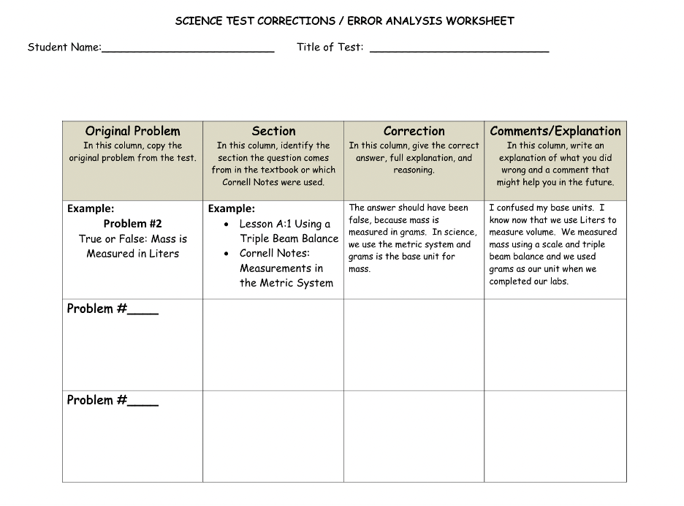

Slide 13
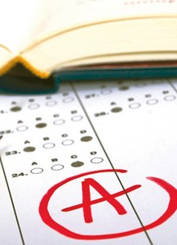
Trimester Exams
Trimester Exams are given at the end of trimester 1 and 3.
Trimester Exams count as one Summative grade and are not eligible to retake, per Diocesan policy.
There will be a study guide for the exam, and we will review in class.
Trimester 1: Covers only Trimester 1 material
Trimester 3:
6th and 7th covers only Trimester 3 material
8th covers material covered throughout the entire year
This Photo by Unknown author is licensed under CC BY-NC-ND.

Slide 14
EXTRA ASSISTANCE OPPORTUNITIES
I will be available, by appointment only, for help sessions either before or after school on select days. These sessions will be to answer specific questions, not to reteach an entire unit. Students should be prepared with their questions in advance using a student inquiry form.

Slide 15
Textbook, Resources, and Organization
Textbook
Pearson Elevate (Pearson Education Inc 2019)https://www.savvasrealize.com/index.html#/
Gizmo Virtual Labs https://www.explorelearning.com/
Organization
Students will keep all paper assessments, quizzes, and tests in science folder.
Online notes and assignments through OneNote, digital textbook, Gizmo Virtual Labs and other Microsoft Office 365 tools (invited by the teacher – please do not create your own notebook)

Slide 16
Questions?

Slide 17
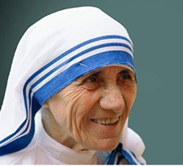
I look forward to a great year! ​
​
Yesterday in gone.​
Tomorrow has not yet come.​
We have only today.​
Let us begin.​
-Mother Teresa​
​
Please do not hesitate to contact me if you have any concerns or questions.​
​
Ashley Johnson ajohnson@mtctampa.org​

